Slide 36
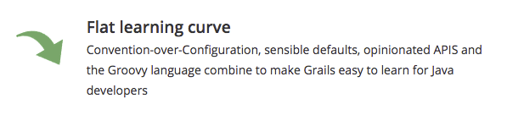
Getting Started with Grails
http://www.grails.org/

Slide 37
Getting Started with Grails
Using Linux (or MacOS) is highly recommended.
Outside of the MS ecosystem, most of web applications run on Linux.
Most tools are easily installed, better supported
Linux is free, can be installed in VM

Slide 38
Virtual Machine
VirtualBox
Free to use from Oracle, Open Source
https://www.virtualbox.org/
VMware
Commercial software, UWO CS students can get a free academic license
http://www.csd.uwo.ca/help/software/vmap.html
Notes:
Windows users should download VMWare Workstation

Slide 39
Distributions of Linux
Too many to name
I’ve had good luck with Linux Mint
https://www.linuxmint.com/
If you haven’t used Linux much before, now is a great time to get acquainted.

Slide 40
Installing Linux on a Virtual Machine
Download image file
https://www.linuxmint.com/download.php
Select a Desktop Environment and Architecture
Cinnamon and 64-bit is probably suitable
Select a download mirror

Slide 41
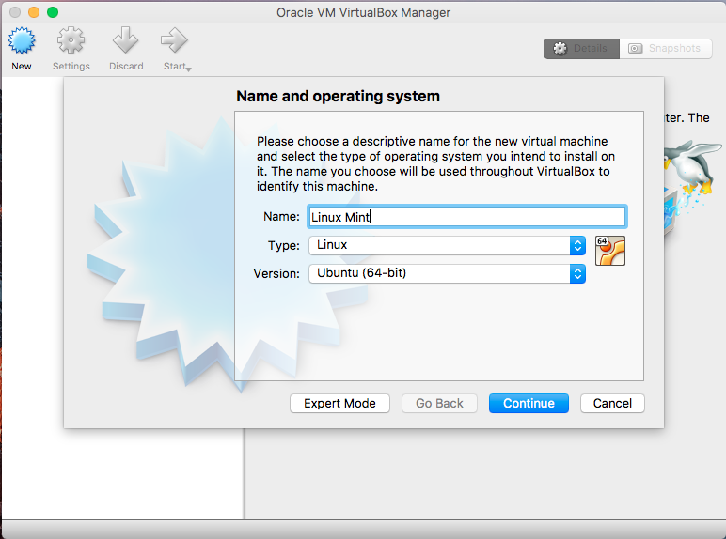

Slide 42
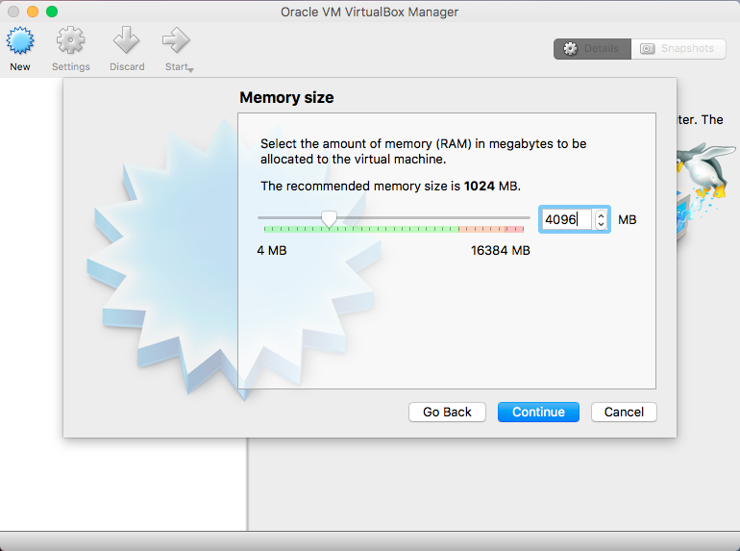

Slide 43
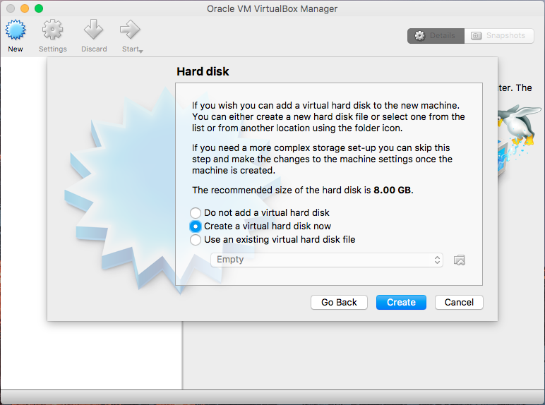

Slide 44
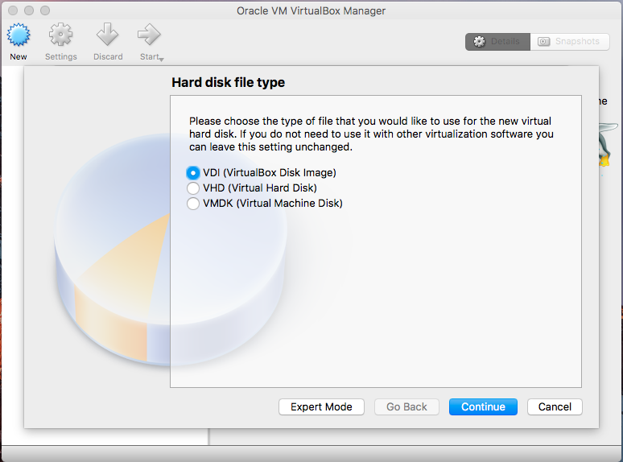

Slide 45
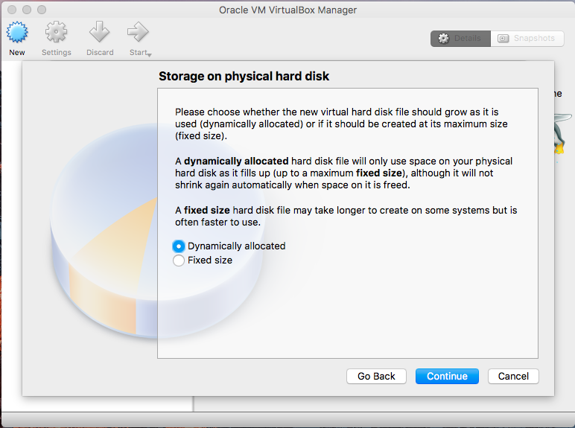

Slide 46
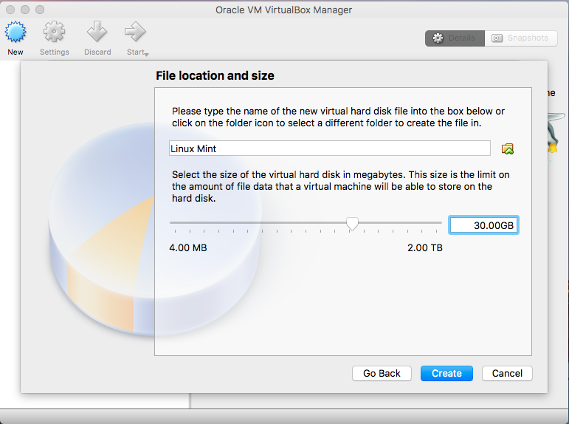

Slide 47
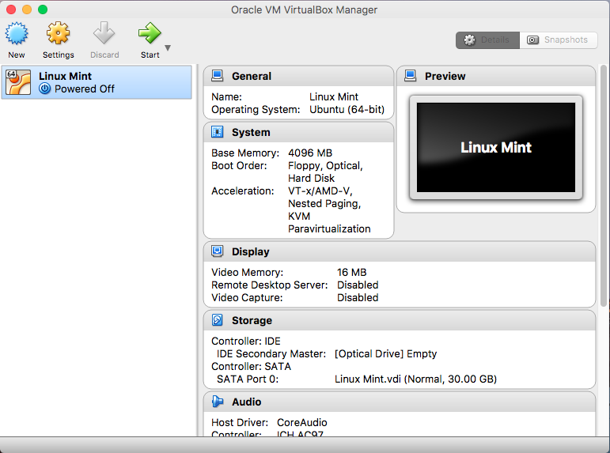

Slide 48
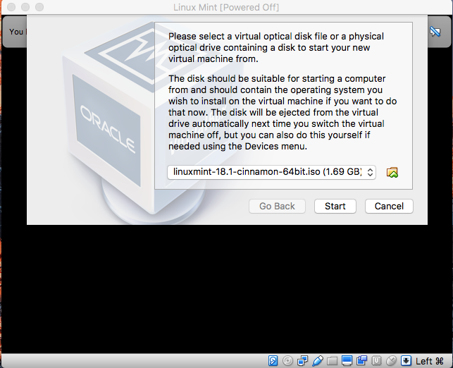

Slide 49
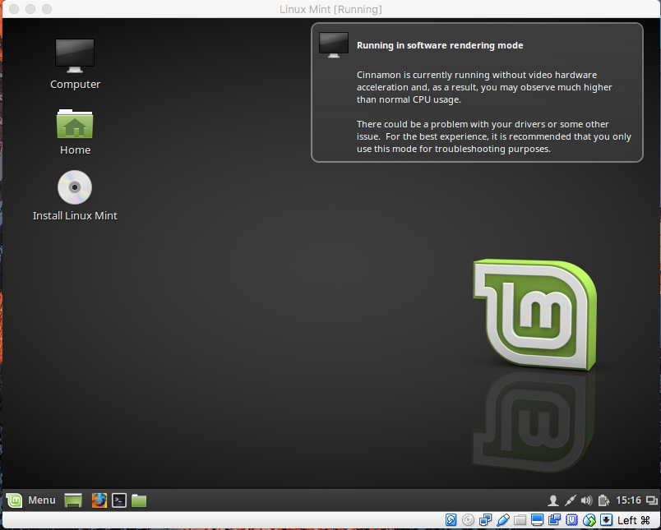

Slide 50
Installing Linux
On-screen instructions are easy to follow
If you make a mistake, don’t worry!
Nice advantage of using virtual machine

Slide 51
Installing Grails
Many ways to do this
The following method works nicely for Linux and MacOS
Requirements:
Installed JDK
Software we will download
IntelliJ Ultimate
SDKMAN
Grails

Slide 52
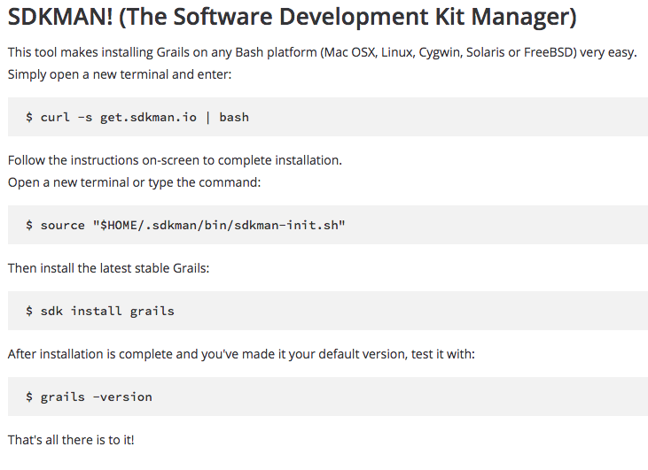
https://grails.org/download.html

Slide 53
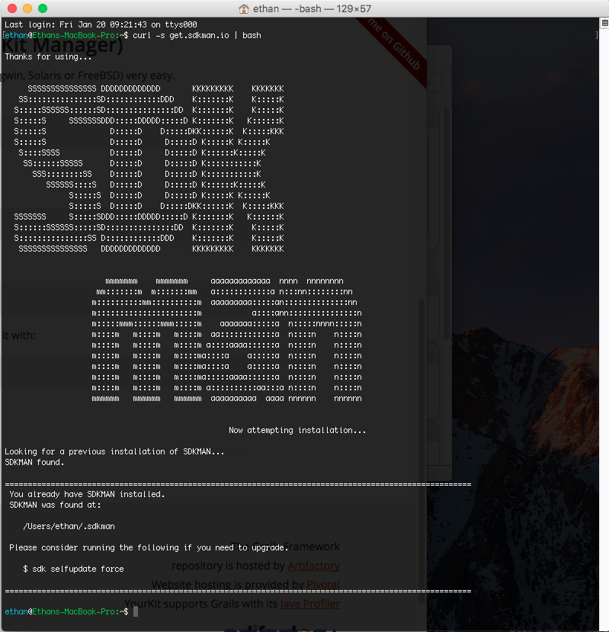

Slide 54
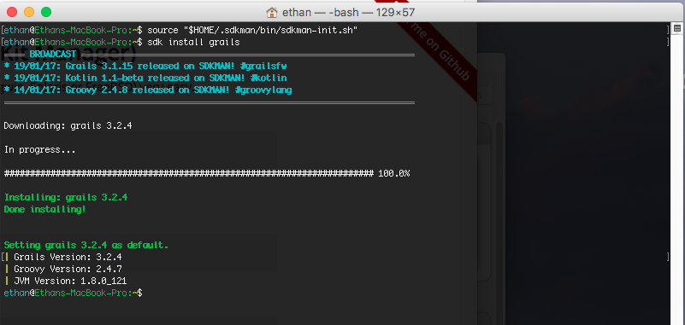

Slide 55
IDE Integration
Grails documentation recommends IntelliJ IDE
This is also my recommendation
You can get the Ultimate Edition for free if you register as a student (highly recommended)

Slide 56
Creating an Application
Applications can be created using Terminal or an IDE

Slide 57
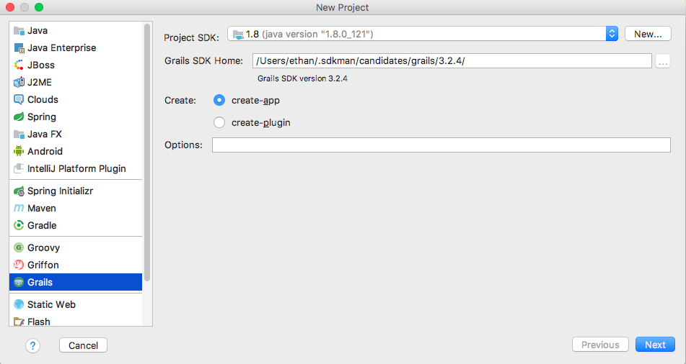

Slide 58
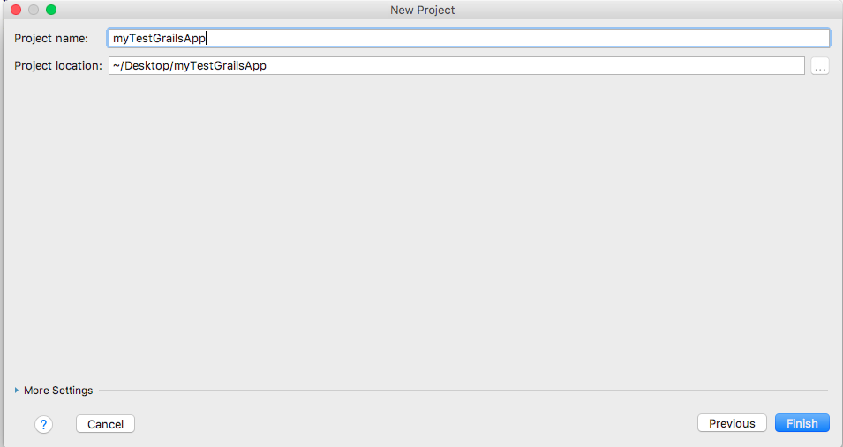

Slide 59
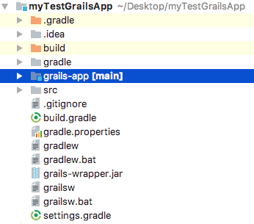
Grails Project Structure
Project Structure is automatically built.
Build automation (Gradle) is
automatically configured.

Slide 60
Running Application
Run application from Terminal
Navigate to project root directory
Start grails by typing grails
Start application by typing run-app

Slide 61
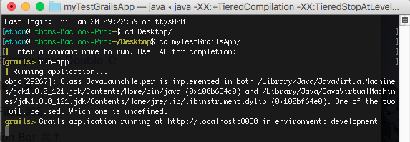

Slide 62
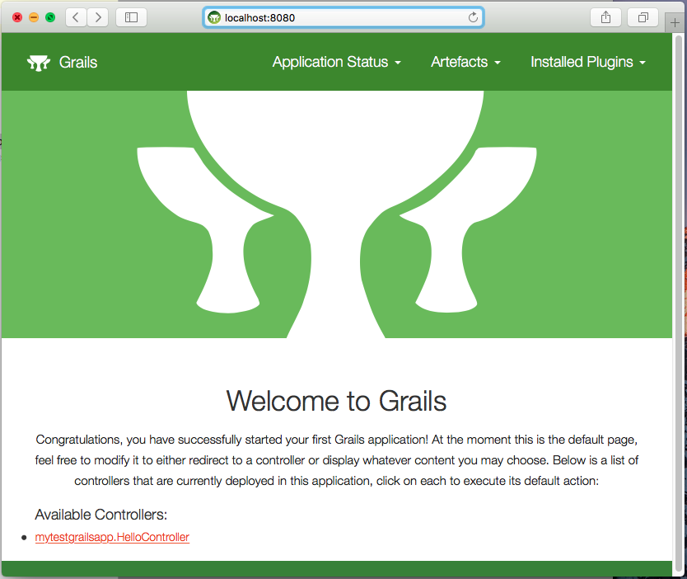

Slide 63
Coming soon…
Selected Grails tutorials
Example code on the course GitHub
Some basic front-end implementation
Integration with Java classes (important)

